Slide 1
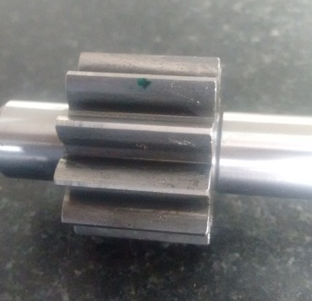
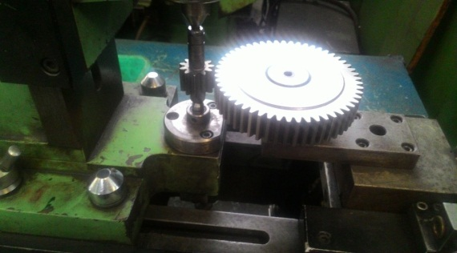
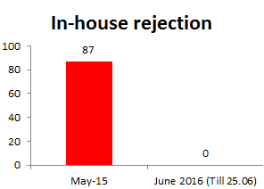
P15
TPM CIRCLE NO :- 01
ACTIVITY
KK
QM
PM
JH
SHE
OT
DM
E&T
KAIZEN IDEA SHEET
TPM CIRCLE NAME: Achiever
LOSS NO. / STEP
DEPT :- IQA
RESULT AREA
P
Q
A
C
D
S
M
CELL:- A225
CELL NAME:- A225
MACHINE / STAGE :- Hobing
OPERATION :- Hobing
KAIZEN THEME: To Eliminate rejection A225 shaft driving Burr stick on gear flanks
IDEA :- Hob shifting frequency changed from 50 nos to 30 nos in hobing operation.
PROBLEM PRESENT STATUS :- A225 shaft driving Burr stick on gear flanks
COUNTERMEASURE:- 1.Hob shifting frequency changed from 50 nos to 30 nos in hobing operation.
2. 2)Gear Rolling checking operation started in finish stage to check high points and burr sticky detection.
BENCHMARK
87
TARGET
0
KAIZEN START
18.05.2016
TDC
25.05.2016
KAIZEN FINISH
25.05.2016
TEAM MEMBERS : Dhananjay , Santosh,
Sachin, Sangita
BENEFITS :-
1) Avoid line mark rejection
Before
After
KAIZEN SUSTENANCE
WHY - WHY ANALYSIS :-
Why1 :- A225 shaft driving Burr stick on gear flanks
Why2 :-Excessive Hob Blunt.
Why3 :- Hob changing and shifting frequency is more.
RESULT :-
WHAT TO DO:- Hob shifting
HOW TO DO:- Check visually.
FREQUENCY :-After 30 No’s
SCOPE & PLAN FOR HORIZONTAL DEPLOYMENT
Sr. No | CELL | RESPONCIBILITY | STATUS
1 | A225 Geaer I | Mr. Khengat | Completed
ROOT CAUSE : Hob changing and shifting frequency is more.
REGISTRATION NO. & DATE : 18.05.2016
REGISTERED BY :-IQA Team.
MANAGER’S SIGN :-Sandip Patil, Sunil kinkar

